Slide 1
Basic Programming
Data Type
Operator
Input Output

Slide 2
What a Is a Program Made Of?
Common elements in programming languages:
  Key Words
  Programmer-Defined Identifiers
  Operators
  Punctuation
  Syntax

Slide 3
Key Words
Also known as reserved words
Have a special meaning in C++
Can not be used as identifier
Written using lowercase letters
Examples in program (shown in green):
using namespace std;
int main()

Slide 4
Example Program
#include <iostream>
using namespace std;
int main()
{
double num1 = 5,
num2, sum;
num2 = 12;
sum = num1 + num2;
cout << "The sum is " << sum;
return 0;
}

Slide 5
Operators
Used to perform operations on data
Many types of operators
  Arithmetic: +, -, *, /
  Assignment: =
Examples in program (shown in green):
num2 = 12;
sum = num1 + num2;

Slide 6
Example Program
#include <iostream>
using namespace std;
int main()
{
double num1 = 5, num2, sum;
num2 = 12;
sum = num1 + num2;
cout << "The sum is " << sum;
return 0;
}

Slide 7
Punctuation
Characters that mark the end of a statement, or that separate items in a list
Example in program (shown in green):
double num1 = 5,
num2, sum;
num2 = 12;

Slide 8
Example Program
#include <iostream>
using namespace std;
int main()
{
double num1 = 5,
num2, sum;
num2 = 12;
sum = num1 + num2;
cout << "The sum is " << sum;
return 0;
}

Slide 9
The #include Directive
Inserts the contents of another file into the program
Is a preprocessor directive
  Not part of the C++ language
  Not seen by compiler
Example:
#include <iostream>
No ; goes here

Slide 10
Comments
Are used to document parts of a program
Are written for persons reading the source code of the program
  Indicate the purpose of the program
  Describe the use of variables
  Explain complex sections of code
Are ignored by the compiler

Slide 11
Single-Line Comments
Begin with // through to the end of line
  int length = 12; // length in inches
  int width = 15; // width in inches
  int area; // calculated area
  // Calculate rectangle area
  area = length * width;
Notes:
See pr2-21.cpp

Slide 12
Multi-Line Comments
Begin with /* and end with */
Can span multiple lines
  /*----------------------------
  Here's a multi-line comment
  ----------------------------*/
Can also be used as single-line comments
  int area; /* Calculated area */

Slide 13
The Parts of a C++ Program
Statement | Purpose
// sample C++ program | comment
#include <iostream> | preprocessor directive
using namespace std; | which namespace to use
int main() | beginning of function named main
{ | beginning of block for main
cout << "Hello, there!"; | output statement
return 0; | send 0 back to the operating system
} | end of block for main

Slide 14
Special Characters
Character | Name | Description
// | Double Slash | Begins a comment
# | Pound Sign | Begins preprocessor directive
< > | Open, Close Brackets | Encloses filename used in #include directive
( ) | Open, Close Parentheses | Used when naming function
{ } | Open, Close Braces | Encloses a group of statements
" " | Open, Close Quote Marks | Encloses string of characters
; | Semicolon | Ends a programming statement
Notes:
See pr2-01.cpp

Slide 15
Important Details
C++ is case-sensitive. Uppercase and lowercase characters are different characters. ‘Main’ is not the same as ‘main’.
Every { must have a corresponding }, and vice-versa.

Slide 16
Variables

Slide 17
Variables
A variable is a named location in computer memory (in RAM)
It holds a piece of data
It must be defined before it can be used
Example variable definition:
  double num1;

Slide 18
Example Program
#include <iostream>
using namespace std;
int main()
{
double num1 = 5,
num2, sum;
num2 = 12;
sum = num1 + num2;
cout << "The sum is " << sum;
return 0;
}

Slide 19
Variables, Constants, and the Assignment Statement
Variable
  Has a name and a type of data it can hold
  char letter;
  Is used to reference a location in memory where a value can be stored
  Must be defined before it can be used
  The value that is stored can be changed, i.e., it can “vary”
variable name
data type

Slide 20
Variables
  If a new value is stored in the variable, it replaces the previous value
  The previous value is overwritten and can no longer be retrieved
  int age;
  age = 17; // age is 17
  cout << age; // Displays 17
  age = 18; // Now age is 18
  cout << age; // Displays 18
Notes:
See pr2-07.cpp

Slide 21
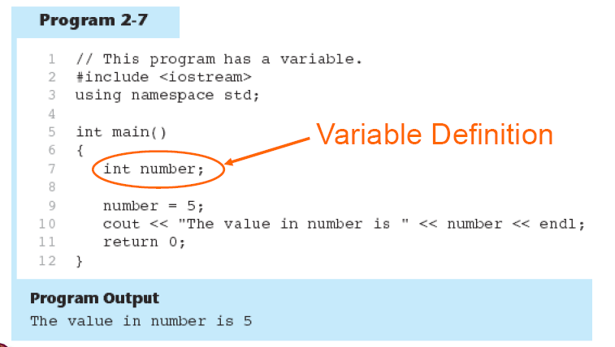
Variables: Example

Slide 22
Identifiers

Slide 23
Identifiers
Programmer-chosen names to represent parts of the program, such as variables
Name should indicate the use of the identifier
Cannot use C++ key words as identifiers
Must begin with alphabetic character or _, followed by alphabetic, numeric, or _ . Alpha may be uppercase or lowercase
Example in program (shown in green):
double num1;

Slide 24
Example Program
#include <iostream>
using namespace std;
int main()
{
double num1 = 5,
num2, sum;
num2 = 12;
sum = num1 + num2;
cout << "The sum is " << sum;
return 0;
}

Slide 25
Valid and Invalid Identifiers
IDENTIFIER | VALID? | REASON IF INVALID
totalSales
total_Sales
total.Sales
4thQtrSales
totalSale$

Slide 26
Lines vs. Statements
In a source file,
  A line is all of the characters entered before a carriage return.
  Blank lines improve the readability of a program.
  Here are four sample lines. Line 3 is blank:
  double num1 = 5, num2, sum;
  num2 = 12;
  sum = num1 + num2;

Slide 27
Literals
Literal: a value that is written into a program’s code.
  "hello, there" (string literal)
  12 (integer literal)

Slide 28
Lines vs. Statements
In a source file,
  A statement is an instruction to the computer to perform an action.
  A statement may contain keywords, operators, programmer-defined identifiers, and punctuation.
  A statement may fit on one line, or it may occupy multiple lines.
  Here is a single statement that uses two lines:
  double num1 = 5,
  num2, sum;

Slide 29
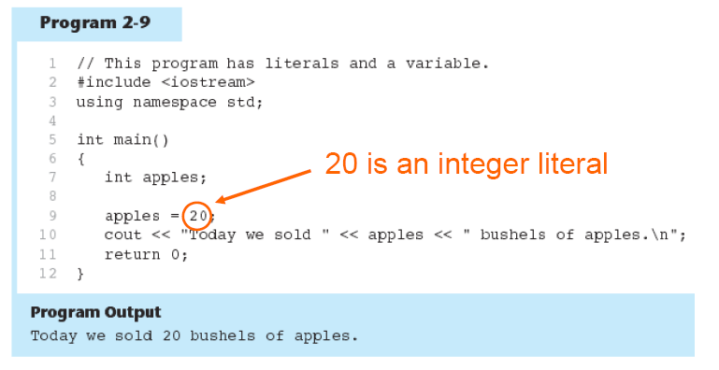
Literals: Example

Slide 30
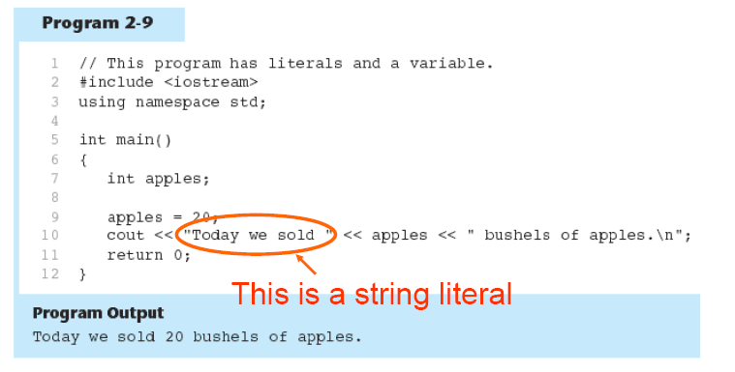
Literals: Example

Slide 31
In-Class Exercise
Examine the following program. List all the variables and literals that appear in the program.
#include <iostream>
using namespace std;
int main()
{ int little;
int big;
little = 2;
big = 2000;
cout<<"The little number is " <<little<<endl;
cout<<"The big number is "<<big<<endl;
return 0;
}
Notes:
See pr2-08.cpp

Slide 32
In-Class Exercise
What will the following program display on the screen?
#include <iostream>
using namespace std;
int main()
{
int num;
num = 712;
cout<< "The value is " << num << endl;
return 0;
}

Slide 33
Input and Output

Slide 34
Input using cin

Slide 35
The cin Object
Standard input object
Like cout, requires iostream file
Used to read input from keyboard
Information retrieved from cin with >>
Input is stored in one or more variables

Slide 36
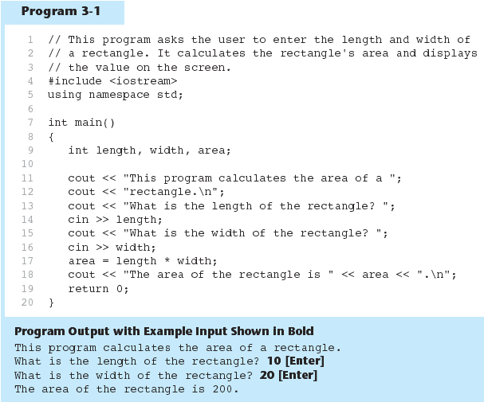

Slide 37
The cin Object
cin converts data to the type that matches the variable:
  int height;
  cout << "How tall is the room? ";
  cin >> height;

Slide 38
The cin Object
Can be used to input more than one value:
  cin >> height >> width;
Multiple values from keyboard must be separated by spaces
Order is important: first value entered goes to first variable, etc.

Slide 39
Displaying a Prompt
A prompt is a message that instructs the user to enter data.
You should always use cout to display a prompt before each cin statement.
cout << "How high is the room? ";
cin >> height;

Slide 40
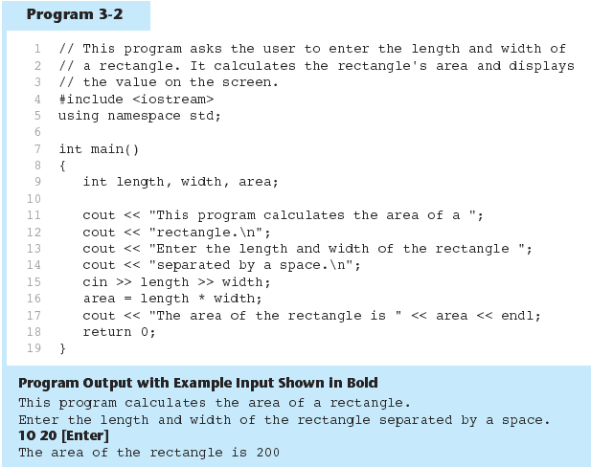

Slide 41
Reading Strings with cin
Can be used to read in a string
Must first declare an array to hold characters in string:
  char myName[21];
myName is a name of an array, 21 is the number of characters that can be stored (the size of the array), including the NULL character at the end
Can be used with cin to assign a value:
  cin >> myName;

Slide 42
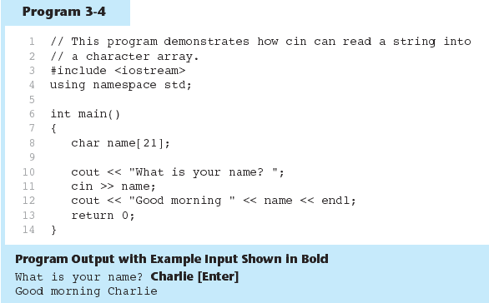

Slide 43
In-Class Exercise
Solve the problem. Add array of characters to the output.
Sample of output:
Enter an integer: 7
Enter a decimal number : 2.25
Enter a single character : R
Enter an array of characters: Programming

Slide 44
Output using cout

Slide 45
The cout Object
Displays information on computer screen
Use << to send information to cout
  cout << "Hello, there!";
Can use << to send multiple items to cout
  cout << "Hello, " << "there!";
  Or
  cout << "Hello, ";
  cout << "there!";
Notes:
See pr2-02.cpp and pr 2-03.cpp

Slide 46
Starting a New Line
To get multiple lines of output on screen
  - Use endl
  cout << "Hello, there!" << endl;
  Use \n in an output string
  cout << "Hello, there!\n";
Notice that the \n is INSIDE
the string.
Notes:
See pr2-04.cpp, pr2-05.cpp, and pr2-06.cpp

Slide 47
In-Class Exercise
Rearrange the following program statements in the correct order.
int main()
}
return 0;
#include <iostream>
cout<<"In 1492 Columbus sailed the ocean blue.";
{
using namespace std;
What is the output of the program when it is properly arranged?

Slide 48
Data type and constant

Slide 49
Number Systems
Numbers can be represented in a variety of ways.
The representation depends on what is called the BASE.
You write these numbers as:
  Number _{base}

Slide 50
Number Systems
The following are the four most common representations.
Decimal (base 10)
  Commonly used
  Valid digits are from 0 to 9
  Example: 12610 (normally written as just 126)
Binary (base 2)
  Valid digits are 0 and 1
  Example: 11111102

Slide 51
The following are the four most common representations.
Octal (base 8)
  Valid digits are from 0 to 7
  Example: 1768
Hexadecimal (base 16)
  Valid digits are from 0 to 9 and A to F (or from a to f)
  Example: 7E16

Slide 52
Integer Data Types
Designed to hold whole numbers
Can be signed or unsigned
  12 -6 +3
Available in different sizes (i.e., number of bytes): short, int, and long
Size of short ≤ size of int ≤ size of long

Slide 53
Integral Constants
To store an integer constant in a long memory location, put ‘L’ at the end of the number: 1234L
Constants that begin with ‘0’ (zero) are octal, or base 8: 075
Constants that begin with ‘0x’ are hexadecimal, or base 16: 0x75A

Slide 54
Defining Variables
Variables of the same type can be defined
  - In separate statements
  int length;
  int width;
  - In the same statement
  int length,
  width;
Variables of different types must be defined in separate statements
Notes:
See pr2-09.cpp and pr2-10.cpp

Slide 55
Floating-Point Data Types
Designed to hold real numbers
  12.45 -3.8
Stored in a form similar to scientific notation
Numbers are all signed
3 data types to represent floating-point numbers: float, double, and long double
Size of float ≤ size of double
≤ size of long double
Notes:
See pr2-15.cpp

Slide 56
Floating-point Constants
Can be represented in
  Fixed point (decimal) notation:
  31.4159 0.0000625
  E notation:
  3.14159E1 6.25e-5
Are double by default
Can be forced to be float 3.14159F or long double 0.0000625L

Slide 57
Assigning Floating-point Values to Integer Variables
If a floating-point value is assigned to an integer variable
  The fractional part will be truncated (i.e., “chopped off” and discarded)
  The value is not rounded
  int rainfall = 3.88;
  cout << rainfall; // Displays 3

Slide 58
The bool Data Type
Represents values that are true or false
bool values are stored as small integers
false is represented by 0, true by 1
  bool allDone = true;
  bool finished = false;
allDone finished
1
0
Notes:
See pr2-16.cpp

Slide 59
The char Data Type
Used to hold single characters or very small integer values
Usually occupies 1 byte of memory
A numeric code representing the character is stored in memory
SOURCE CODE MEMORY
char letter = 'C'; letter
67
Notes:
See pr2-11.cpp, pr2-12.cpp, and pr2-13.cpp

Slide 60
The char Data Type
Used to hold single characters or very small integer values
Usually occupies 1 byte of memory
A numeric code representing the character is stored in memory
SOURCE CODE MEMORY
char letter = 'C'; letter
67
Notes:
See pr2-11.cpp, pr2-12.cpp, and pr2-13.cpp

Slide 61
In-Class Exercise
What is wrong with the following program?
#include <iostream>
using namespace std;
int main()
{ char letter;
letter = "Z";
cout<<letter<<endl;
return 0;
}

Slide 62
Summary of data types
Name | Description | Size | Range
char | Character or small integer. | 1byte | signed: -128 to 127 unsigned: 0 to 255
short int (short) | Short Integer. | 2bytes | signed: -32768 to 32767 unsigned: 0 to 65535
int | Integer. | 4bytes | signed: -2147483648 to 2147483647 unsigned: 0 to 4294967295
long int (long) | Long integer. | 4bytes | signed: -2147483648 to 2147483647 unsigned: 0 to 4294967295
bool | Boolean value. It can take one of two values: true or false. | 1byte | true or false
float | Floating point number. | 4bytes | +/- 3.4e +/- 38 (~7 digits)
double | Double precision floating point number. | 8bytes | +/- 1.7e +/- 308 (~15 digits)
long double | Long double precision floating point number. | 8bytes | +/- 1.7e +/- 308 (~15 digits)

Slide 63
Naming Constant

Slide 64
Named Constants
Named constant (constant variable): variable whose content cannot be changed during program execution
Used for representing constant values with descriptive names:
  const double TAX_RATE = 0.0675;
  const int NUM_STATES = 50;
Often named in uppercase letters

Slide 65
Defining constants
You can define your own names for constants that you use very often without having to resort to memory-consuming variables, simply by using the #define preprocessor directive.
Its format:
  #define identifier value
Example:
#include <iostream>
using namespace std;
#define PI 3.14159
#define NEWLINE '\n‘
int main ()
{ double r=5.0;
double circle;
circle = 2 * PI * r;
cout << circle;
cout << NEWLINE; return 0;}

Slide 66
Declared constants (const)
With the const prefix you can declare constants with a specific type in the same way as you would do with a variable
Example:
#include <iostream>
using namespace std;
int main ()
{ double r=5.0,circle;
const double PI = 3.14159;
const char NEWLINE = '\n';
circle = 2 * PI * r;
cout << circle;
cout << NEWLINE; return 0;}

Slide 67
String Constant
Can be stored a series of characters in consecutive memory locations
  "Hello"
Stored with the null terminator, \0, at end
Is comprised of characters between the " "
H | e | l | l | o | \0

Slide 68
A character or a string constant?
A character constant is a single character, enclosed in single quotes:
    'C'
A string constant is a sequence of characters enclosed in double quotes:
    "Hello, there!"
A single character in double quotes is a string constant, not a character constant:
    "C"

Slide 69
The C++ string Class
Must #include <string> to create and use string objects
Can define string variables in programs
string name;
Can assign values to string variables with the assignment operator
  name = "George";
Can display them with cout
  cout << name;
Notes:
See pr2-14.cpp

Slide 70
Determining the Size of a Data Type
The sizeof operator gives the size of any data type or variable
double amount;
cout << "A float is stored in "
<< sizeof(float) << " bytes\n";
cout << "Variable amount is stored in "
<< sizeof(amount) << " bytes\n";
Notes:
See pr2-17.cpp

Slide 71
More on Variable Assignments and Initialization
Assigning a value to a variable
  Assigns a value to a previously created variable
  A single variable name must appear on left side of the = symbol
  int size;
  size = 5; // legal
  5 = size; // not legal

Slide 72
Variable Assignment vs. Initialization
Initializing a variable
  Gives an initial value to a variable at the time it is created
  Can initialize some or all variables of definition
  int length = 12;
  int width = 7, height = 5, area;
Notes:
See pr2-18.cpp

Slide 73
Scope
The scope of a variable is that part of the program where the variable may be used
A variable cannot be used before it is defined
  int a;
  cin >> a; // legal
  cin >> b; // illegal
  int b;
Notes:
See pr2-19.cpp

Slide 74
In-Class Exercise
Trace the following program. Can it be compiled?
#include <iostream>
using namespace std;
int main()
{
cout<<value;
int value;
return 0;
}

Slide 75
Arithmetic Expression

Slide 76
Arithmetic Operators and Expression

Slide 77
Arithmetic Operators
Used for performing numeric calculations
C++ has unary, binary, and ternary operators
  unary (1 operand) -5
  binary (2 operands) 13 - 7
  ternary (3 operands) exp1 ? exp2 : exp3

Slide 78
Binary Arithmetic Operators
SYMBOL | OPERATION | EXAMPLE | ans
+ | addition | ans = 7 + 3; | 10
- | subtraction | ans = 7 - 3; | 4
* | multiplication | ans = 7 * 3; | 21
/ | division | ans = 7 / 3; | 2
% | modulus | ans = 7 % 3; | 1
Notes:
See pr2-20.cpp

Slide 79
/ Operator
C++ division operator (/)performs integer division if both operands are integers
  cout << 13 / 5; // displays 2
  cout << 2 / 4; // displays 0
If either operand is floating-point, the result is floating-point
  cout << 13 / 5.0; // displays 2.6
  cout << 2.0 / 4; // displays 0.5

Slide 80
% Operator
C++ modulus operator (%) computes the remainder resulting from integer division
  cout << 9 % 2; // displays 1
% requires integers for both operands
  cout << 9 % 2.0; // error

Slide 81
In-Class Exercise
Identify as many syntax errors as you can in the following program
*/ what is wrong with this program?/*
#include iostream
using namespace std;
int main();
}
int a, b, c
a=3
b=4
c=a+b
Cout<"The value of c is "<C;
return 0;
{

Slide 82
Order of Operations
In an expression with more than one operator, evaluation is in this order:
()
  - (unary negation), in order, right to left
  * / %, in order, left to right
  + -, in order, left to right
In the expression 2 + 2 * 2 – 2
evaluate
first
evaluate
third
evaluate
second

Slide 83
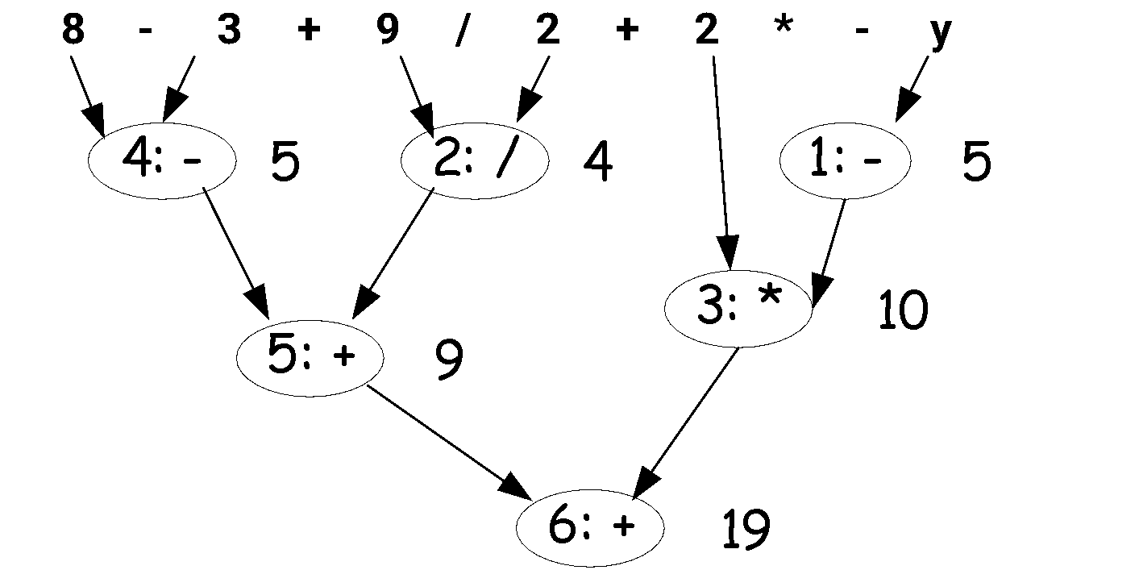
Example
int z, y=-5;
z= 8 - 3 + 9 / 2 + 2 * - y;
z= 8 - (3 + 9 / 2) + 2 * - y;// try this

Slide 84
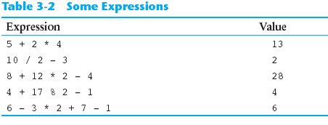
Order of Operations
Show prove for the following expression

Slide 85
Associativity of Operators
- (unary negation) associates right to left
*, /, %, +, - associate left to right
parentheses ( ) can be used to override the order of operations:
  2 + 2 * 2 – 2 = 4
  (2 + 2) * 2 – 2 = 6
  2 + 2 * (2 – 2) = 2
  (2 + 2) * (2 – 2) = 0

Slide 86
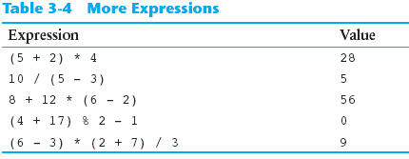
Grouping with Parentheses

Slide 87
Type Conversion

Slide 88
When You Mix Apples and
Oranges: Type Conversion
Operations are performed between operands of the same type.
If not of the same type, C++ will convert one to be the type of the other
This can impact the results of calculations.

Slide 89
Type Conversion
Type Conversion: automatic conversion of an operand to another data type
Promotion: convert to a higher type
Demotion: convert to a lower type

Slide 90
Hierarchy of Types
Highest:
Lowest:
Ranked by largest number they can hold
long double
double
float
unsigned long
long
unsigned int
int

Slide 91
Conversion Rules
char, short, unsigned short automatically promoted to int
  For arithmetic operation
  char c=‘A’; cout<<6+c; // int
When operating on values of different data types, the lower one is promoted to the type of the higher one.
int i=25; cout<<6.1+i; // float
When using the = operator, the type of expression on right will be converted to type of variable on left
int x, y =25; float z=2.5;
x=y+z; //int

Slide 92
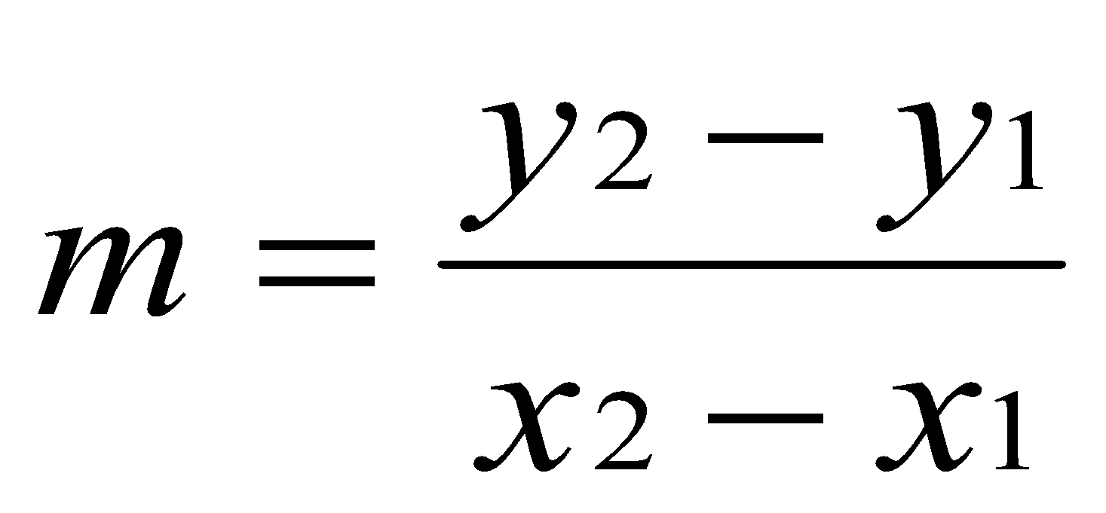
Algebraic Expressions
Multiplication requires an operator:
  Area=lw is written as Area = l * w;
There is no exponentiation operator:
  Area=s² is written as Area = pow(s, 2);
Parentheses may be needed to maintain order of operations:
  is written as
  m = (y2-y1) /(x2-x1);

Slide 93
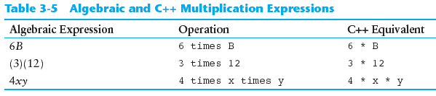
Algebraic Expressions

Slide 94
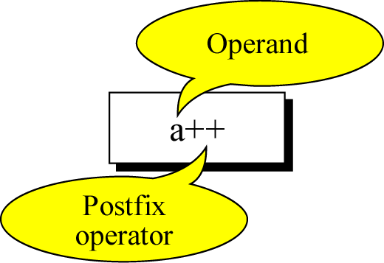
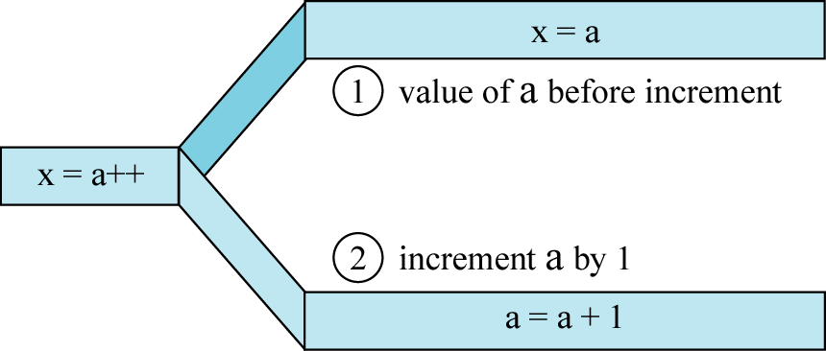
Postfix expression

Slide 95
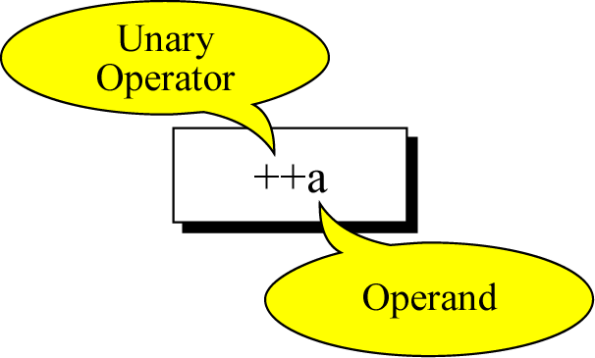
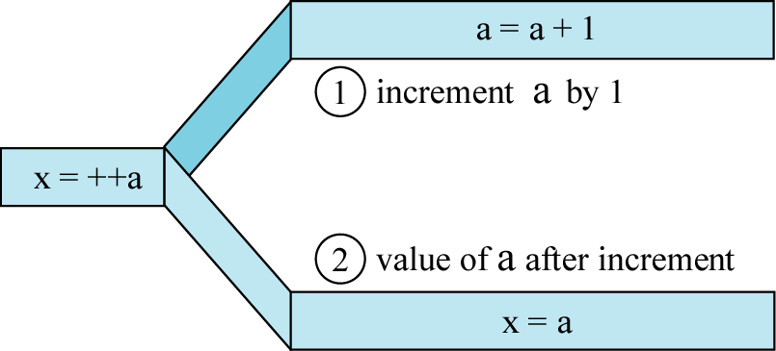
Prefix expression

Slide 96
In-Class Exercise
What would be the value of nilai_kedua:
  int kira = 5;
  int nilai_pertama = 10, nilai_kedua;
  nilai_kedua= 5* kira-- + nilai_pertama;
  nilai_kedua = 5* --kira +nilai+pertama;

Slide 97
Overflow and Underflow

Slide 98
Overflow and Underflow
Occurs when assigning a value that is too large (overflow) or too small (underflow) to be held in a variable
Variable contains value that is ‘wrapped around’ set of possible values
Different systems may display a warning/error message, stop the program, or continue execution using the incorrect value

Slide 99
Type Casting

Slide 100
Type Casting
Used for manual data type conversion
Useful for floating point division using int:
double m;
m = static_cast<double>(y2-y1)
/(x2-x1);
Useful to see int value of a char variable:
char ch = 'C';
cout << ch << " is "
<< static_cast<int>(ch);

Slide 101
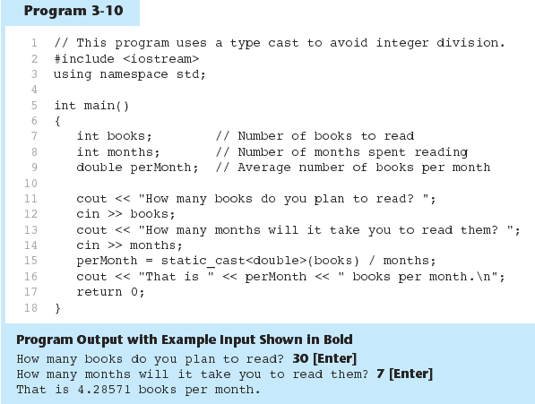
Example

Slide 102
C-Style and Prestandard
Type Cast Expressions
C-Style cast: data type name in ()
cout << ch << " is " << (int)ch;
Prestandard C++ cast: value in ()
cout << ch << " is " << int(ch);
Both are still supported in C++, although static_cast is preferred

Slide 103
Multiple Assignment and Combined Assignment

Slide 104
Multiple Assignment and
Combined Assignment
The = can be used to assign a value to multiple variables:
  x = y = z = 5;
Value of = is the value that is assigned
Associates right to left:
  x = (y = (z = 5));
value
is 5
value
is 5
value
is 5

Slide 105
Combined Assignment
Look at the following statement:
  sum = sum + 1;
  This adds 1 to the variable sum.

Slide 106
Combined Assignment
The combined assignment operators provide a shorthand for these types of statements.
The statement
  sum = sum + 1;
  is equivalent to
  sum += 1;

Slide 107
Combined Assignment Operators
Operator | Example | Equivalent to
+= | i+=3 i += j +3 | i = i+3 i = i + (j+3)
-= | i-=3 i -= j +3 | i = i-3 i = i - (j+3)
*= | i*=3 i *= j +3 | i = i*3 i = i * (j+3)
/= | i/=3 i /= j +3 | i = i/3 i = i / (j+3)
%= | i%=3 i %= j +3 | i = i%3 i = i % (j+3)

Slide 108
In-Class Exercise
Assume that int a = 1 and double d = 1.0, and that each expression is independent. What are the results of the following expressions?
  a = 46/9;
  a = 46 % 9 + 4 * 4 – 2;
  a = 45 + 43 % 5 * (23 * 3 % 2);
  a %=3 / a + 3;
  d += 1.5 * 3 + (++a);
  d -= 1.5 * 3 + a++;

